Slide 1
Google Month ‘Digital Alphabet’
Week 2; Tips and Resources

Slide 2
Upskill with our Digital Marketing ‘tips’ in our Digital Alphabet for Google Month 2014

Slide 3
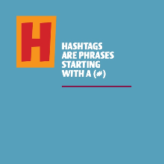
H
Hashtags are phrases starting with a (#), & used on social media sites to identify messages on a specific topic.
Hashtags are essential if you want to be retweeted by your followers on Twitter.
Having a content management strategy is key to ensuring that your content is optimised on your website, blog and social media channels such as Facebook and Twitter.
Find out more here:
http://linkd.in/1v9CfEd
www.jeffbullas.com

Slide 4
I
Infographics are a great way of presenting visually appealing content.
Instagram has 200 million monthly active users and since its acquisition by Facebook it has been growing even more rapidly.
Include the share icons to the main social media channels on your website/blog to spur users into sharing your content..
Find out more here:
www.instagram.com
http://www.razorsocial.com/social-sharing/

Slide 5
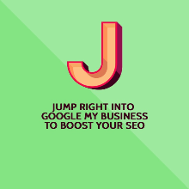
J
Jump right in and get started on Google My Business, it will boost your Search Engine Optimisation!
Just by showing commitment to your customers and delivering consistently on your service promise in your online dealings with customers, you can build a reputation for your business for service excellence.
Junk mail can be the end destination for emails to customers,
if you use too many images in your message or
if you send an attachment with your message.
Find out more here:
http://linkd.in/1lgRvY9
http://bit.ly/1sk8NYO
www.google.ie/business

Slide 6
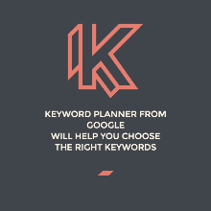
k
Keyword Planner from Google will help you to choose keywords with the best Return on Investment (ROI).
Keep your marketing plan on track by measuring your online performance using tools like Facebook Insights or Google Analytics.
Find out more here:
www.google.com/sktool/
www.google.ie/analytics

Slide 7
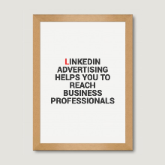
L
LinkedIn Advertising can help you to reach business professionals for your event.
Landing page text should be tailored to the target audience and should make it easy for them to skim and scan through the text quickly.
Load time of your website; i.e. how long it takes your site to download in the user's browser, is a ranking factor in the organic Google results.
Find out more here:
www.linkedin.com
https://support.google.com/webmasters/answer/35769
https://developers.google.com/webmasters/

Slide 8
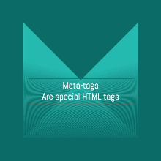
M
Meta-tags are special HTML tags that provide information about a Web page.
Meta-tags are crucial for Search Engine Optimisation; use descriptive page titles and keyword rich meta-descriptions on your website!
Make the most of your website/blog by using a variety of high quality, shareable images with your text.
Find out more here:
https://support.google.com/webmasters/answer/35769
www.searchenginewatch.com

Slide 9
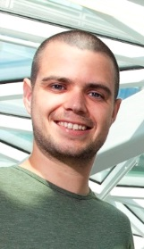
Google month
Week 2 Hangout
Meet the speakers
Join us for Week 2 of our series of ‘Google Month’ Hangouts on Google AdWords & Analytics, and learn how to run and structure an AdWords campaign that suits your business needs!
Stephen Power, Google
Lorna Mellon, Google
Click here to view Hangout

Slide 10
Don’t miss week 3 of our digital alphabet for google month!
Learn about optimising your website with clear navigation, best practice in website design, how to make the most of your Pay Per Click advertising campaigns….and much, much more!

