Slide 1
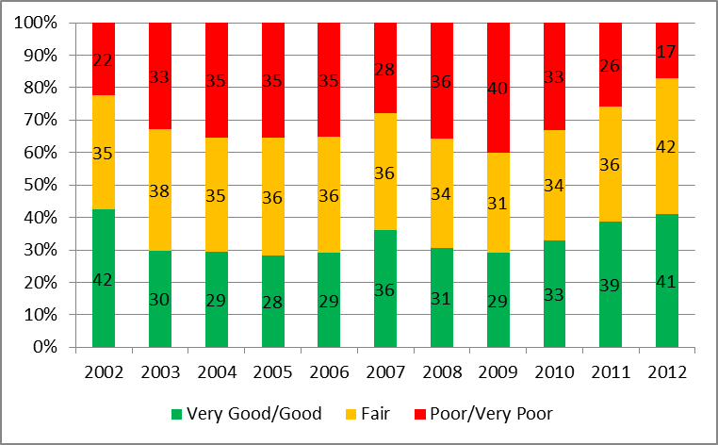
Overseas Visitors
2002-2012
All Ratings: value for money

Slide 2

US
Visitors
2002-2012
All Ratings: value for money
US Visitors

Slide 3
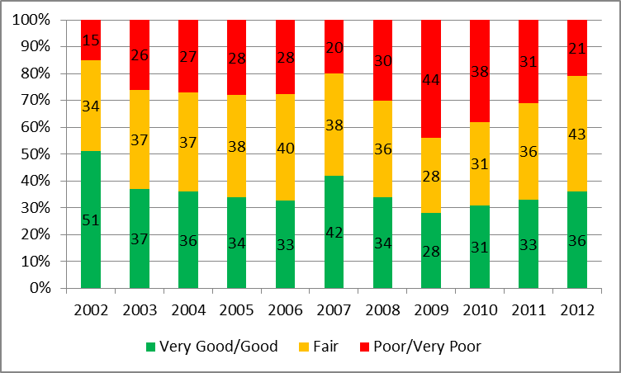
British Visitors
2002-2012
All Ratings: value for money
British Visitors

Slide 4

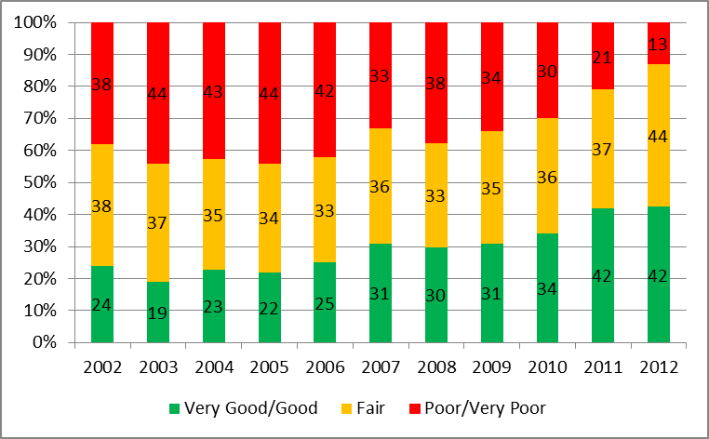
Other European
Visitors
2002-2012
All Ratings: value for money
All European Visitors

Slide 5

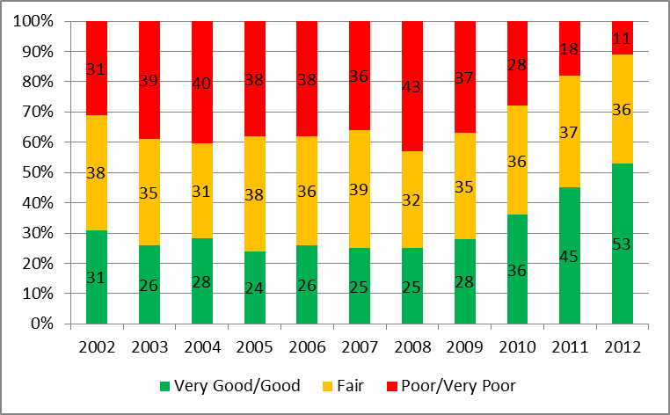
French
Visitors
2002-2012
All Ratings: value for money
French Visitors

Slide 6

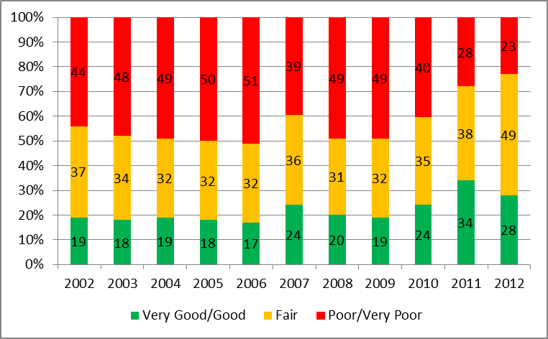
German
Visitors
2002-2012
All Ratings: value for money
German Visitors

Slide 7
Overseas Visitors
2002-2012
Net rating of value for money*
*(net result when ‘poor’ or ‘very poor’ score are subtracted from ‘good’ or very good’ scores)

Slide 8
US
Visitors
2002-2012
Net rating of value for money*
US Visitors
*(net result when ‘poor’ or ‘very poor’ score are subtracted from ‘good’ or very good’ scores)

Slide 9
British Visitors
2002-2012
Net rating of value for money*
British Visitors
*(net result when ‘poor’ or ‘very poor’ score are subtracted from ‘good’ or very good’ scores)

Slide 10
Other European
Visitors
2002-2012
Net rating of value for money*
All European Visitors
*(net result when ‘poor’ or ‘very poor’ score are subtracted from ‘good’ or very good’ scores)

Slide 11
French
Visitors
2002-2012
Net rating of value for money*
French Visitors
*(net result when ‘poor’ or ‘very poor’ score are subtracted from ‘good’ or very good’ scores)

Slide 12
German
Visitors
2002-2012
Net rating of value for money*
German Visitors
*(net result when ‘poor’ or ‘very poor’ score are subtracted from ‘good’ or very good’ scores)

